Slide 1
CSSE3113 – Introduction to Software Engineering
Software Quality

Slide 2
Software Quality
An effective software process applied in a manner that creates a useful product that provides measurable value for those who produce it and those who use it.
An effective software process establishes the infrastructure that supports any effort at building a high-quality software product.
A useful product delivers the content, functions, and features that the end user desires, but as important, it delivers these assets in a reliable, error-free way.
By adding value for both the producer and user of a software product, high quality software provides benefits for the software organization and the end user community

Slide 3
Software Quality Dilemma
Good Enough Software
Delivers high-quality functions and features that end users desire, but at the same time it delivers other more obscure or specialized functions and features that contain known as bugs.
The software vendor hopes that the vast majority of end users will overlook the bugs because they are so happy with other application functionality
When you deliver a good enough (buggy) product, you risk permanent damage to your company’s reputation.

Slide 4
Software Quality Dilemma
Cost of Quality
The cost of quality includes all costs incurred in the pursuit of quality or in performing quality-related activities and the downstream costs of lack of quality.
An organization must collect metrics
To provide a baseline for the current cost of quality
Identify opportunities for reducing these costs
Provide a normalized basis of comparison
The cost of quality can be divided into costs associated :
Prevention
Appraisal
Failure
Internal Failure
External Failure

Slide 5
Software Quality Dilemma
Prevention Cost:
Cost of management activities
The cost of added technical activities to develop complete requirements and design models
Test planning costs
The cost of all training associated with these activities
Appraisal costs:
It include activities to gain insight into product condition the “first time through” each process.
Examples Include:
The cost of conducting technical reviews for software engineering work products.
The cost of data collection and metrics evaluation.
The cost of testing and debugging

Slide 6
Software Quality Dilemma
Failure costs
Failure costs are those that would disappear if no errors appeared before shipping a product to customers.
It is divided into two categories.
Internal Failure Cost
External Failure Cost
Internal failure costs are incurred when you detect an error in a product prior to shipment.
External failure costs are associated with defects found after the product has been shipped to the customer.

Slide 7
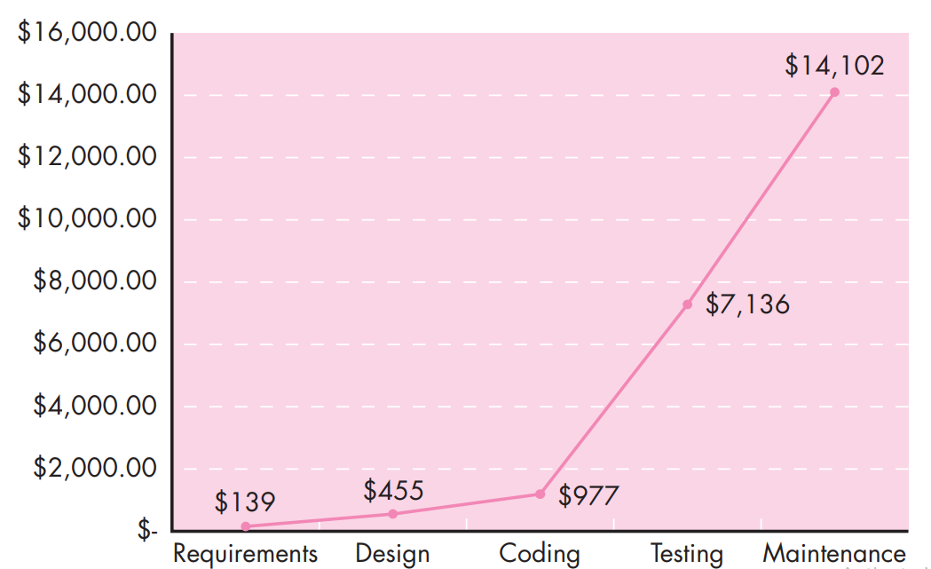
Relative Cost of Correcting Errors and Defects

Slide 8
Software Quality Dilemma
Risks
Low-quality software increases risks for both the developer and the end user.
Negligence and Liability
The following issues come under negligence and liability.
The system is late
The system fails to deliver desired features and functions
The system is error-prone
The system does not meet with customer approval

Slide 9
Software Quality Dilemma
Quality and Security
As the criticality of the software system grows, application security has become increasingly important.
Software that does not exhibit high quality is easier to hack
To build a secure system, you must focus on quality during design.
Elimination of architectural flaws will make it difficult to hack the software.

Slide 10
Software Quality Dilemma
The Impact of Management Actions
Best software engineering practices can be undermined by poor business decisions and questionable project management actions.
As each project task is initiated, a project leader will make decisions related to the following aspects that can have a significant impact on product quality.
Estimation Decisions
Scheduling Decisions
Risk-oriented Decisions

Slide 11
Achieving Software Quality
Software Engineering Methods
Following activities will increase the likelihood of creating high-quality software
Complete understanding of the problem
A comprehensive design that establishes a solid foundation for the construction activity
Appropriate analysis and design methods

Slide 12
Achieving Software Quality
Project Management Techniques
Use of estimation to verify that delivery dates are achievable
Schedule dependencies are understood
The team resists the temptation to use short cuts
Risk planning is conducted so problems do not breed chaos
Explicit techniques for quality and change management

Slide 13
Achieving Software Quality
Quality Control
A set of software engineering actions that help to ensure that each work product meets its quality goals.
Models are reviewed
Code may be inspected in order to uncover and correct errors
A series of testing steps is applied to uncover errors
Measurement and feedback allows a software team to tune the process

Slide 14
Achieving Software Quality
Quality Assurance
It establishes the infrastructure that supports software engineering methods, rational project management, and quality control.
It consists of a set of auditing and reporting functions.
The goal of quality assurance is to provide management and technical staff with the data necessary to be informed about product quality

Slide 15
Architecture Evaluation and Refinement Cost-Benefit Analysis
Design is iterative: we propose design decisions, assess, make adjustments, and propose more decisions
Many techniques to evaluate the design
Trade-off analysis
Cost-benefit analysis
Prototyping
A cost–benefit analysis is a widely used business tool for estimating and comparing the costs and benefits of a proposed change

Slide 16
Architecture Evaluation and Refinement Cost-Benefit Analysis
A cost-benefit analysis contrasts financial benefits with financial costs, both in Dollars
Costs
Development
Operational
Benefits
Reduced Operational Costs
Increased Earnings
Payback period
the length of time before accumulative benefits recover the costs of implementation

Slide 17
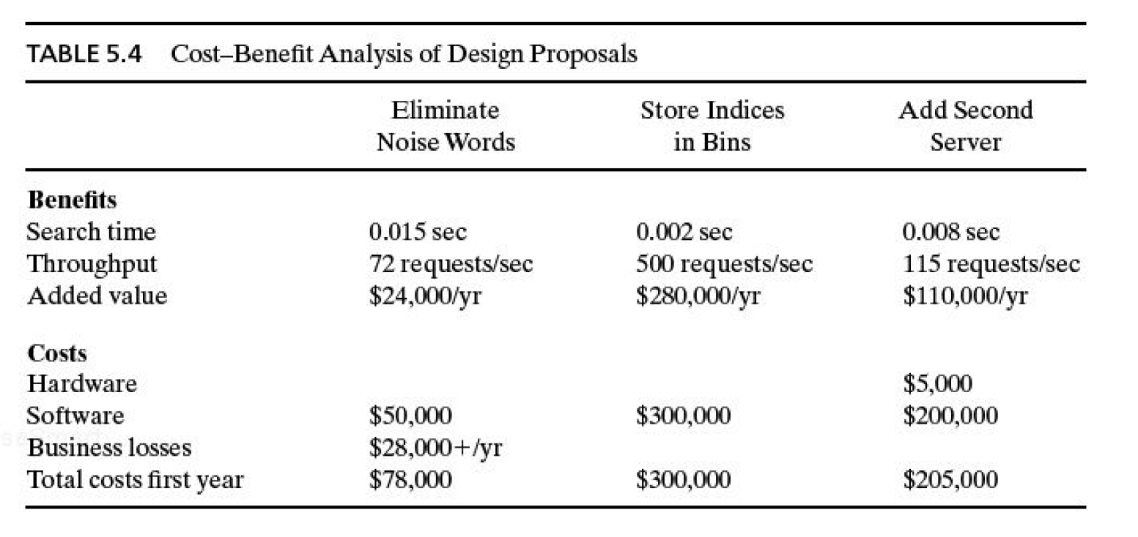
Cost Benefit Analysis of Design Protocols

Slide 18
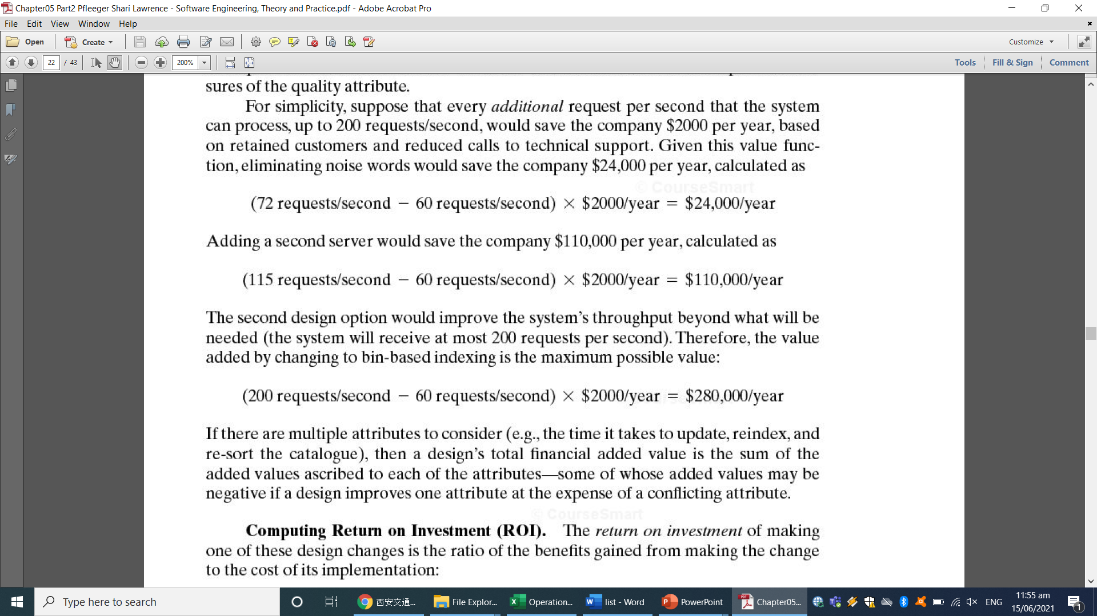
Cost Benefit Analysis of Design Protocols

Slide 19
Architecture Evaluation and Refinement Cost-Benefit Analysis
Return on Investment (ROI)
ROI = Benefits/Cost, ROI > 1 is desired
%age gain ROI = (Benefits – Cost) / Cost x 100
Example
After five years
Cost = $ 2249559
Benefits = $ 6122893
ROI = 2.72 i.e. Total benefits are approx. 3 times the total costs
%age gain ROI = 172.19 % i.e. Your earnings are 172.19 % of the total costs

Slide 20
Architecture Evaluation and Refinement Cost-Benefit Analysis
Return on Investment (ROI) Table
 | 1 year | 5 year | 10 year
Eliminate Noise Words | 24000/78000 = 0.3076 | (24000*5)/{50000+(28000*5)} = 0.6316 | (24000*10)/{50000+(28000*10)} = 0.7273
Store Indices in Bins | 280000/300000 = 0.93 | (280000*5)/ 300000 = 4.667 | (280000*10)/ 300000 = 9.33
Add Second Server | 110000/205000 = 0.53 | (110000*5)/ 205000 = 2.683 | (110000*10)/ 205000 = 5.366

Slide 21
Architecture Evaluation and Refinement Cost-Benefit Analysis
% gain on ROI Table
 | 1 year | 5 year | 10 year
Eliminate Noise Words | {(24000-78000) /78000}*100 = -69.23
Store Indices in Bins | {(280000-300000)/300000} * 100 = -6.667
Add Second Server | {(110000-205000) /205000}*100 = -46.34

Slide 22
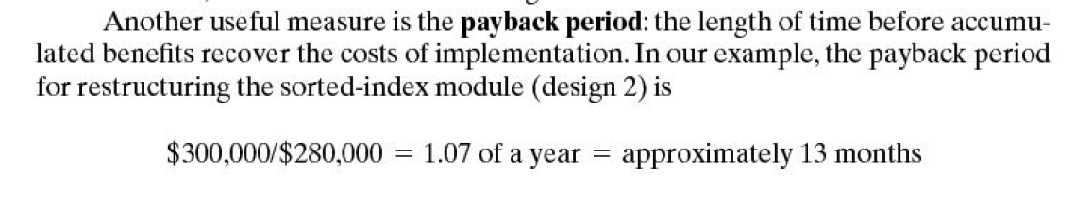
Architecture Evaluation and Refinement Cost-Benefit Analysis
Payback Period Table
 |  | Years
Eliminate Noise Words | 78000/24000 = | 3.25 {it is wrong because 28000 is also added annually}
Store Indices in Bins | 300000/280000 = | 1.07
Add Second Server | 205000/110000 = 0.53 | 1.864

